Slide 1
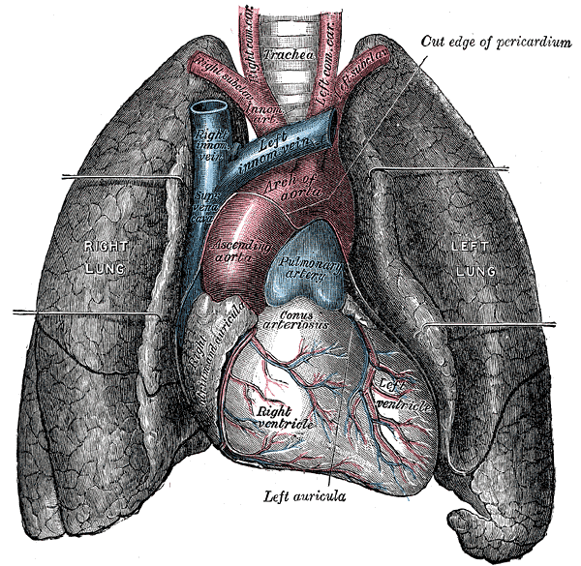
Understanding Health
An Overview of Physical and Mental Well-being
This Photo by Unknown Author is licensed under CC BY-SA

Slide 2

What is Health?
Definition: Health is a state of complete physical, mental, and social well-being, not merely the
absence of disease or infirmity.
Key Components:
Physical Health: Regular exercise, balanced diet, adequate sleep.
Mental Health: Stress management, emotional resilience, mental clarity.
Social Health: Positive relationships, community involvement, effective communication.

Slide 3

Importance of a Healthy Lifestyle
Benefits:
Reduces the risk of chronic diseases like heart disease and diabetes.
Enhances mood and mental clarity.
Improves longevity and quality of life.
Tips for Maintaining Health:
Engage in regular physical activity.
Consume a balanced and nutritious diet.
Ensure adequate sleep and manage stress effectively.

Slide 4
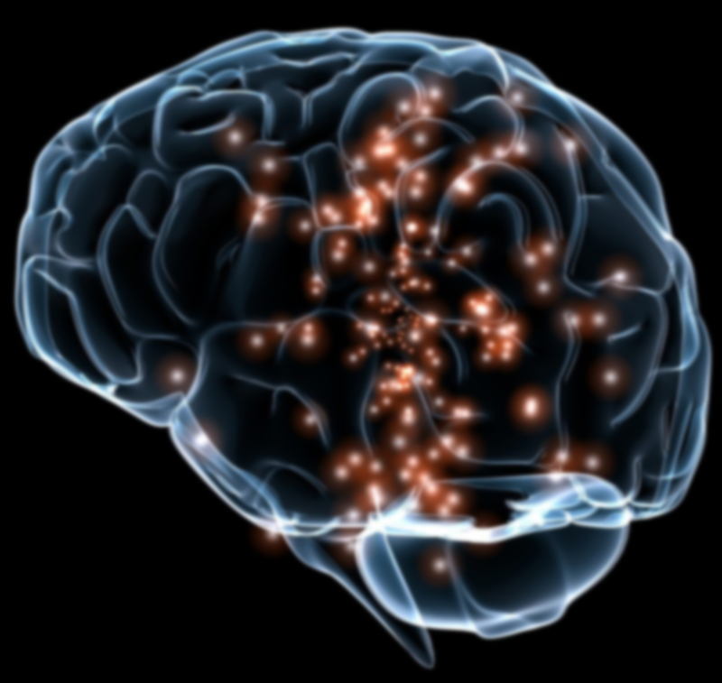
Mental Health Awareness
Understanding Mental Health:
Mental health affects how we think, feel, and act.
It's essential for coping with stress, relating to others, and making choices.
Promoting Mental Well-being:
Practice mindfulness and relaxation techniques.
Seek professional help when needed.
Maintain social connections and engage in enjoyable activities.

Slide 5

Preventive Healthcare
Importance of Prevention:
Prevents the onset of diseases and health complications.
Reduces healthcare costs and improves quality of life.
Preventive Measures:
Regular health screenings and check-ups.
Vaccinations and immunizations.
Adopting healthy habits early in life.

Slide 6

Global Health Challenges
Current Global Health Issues:
Rise in non-communicable diseases (NCDs) like obesity and diabetes.
Mental health disorders becoming more prevalent.
Access to healthcare remains a challenge in many parts of the world.
Call to Action:
Advocate for health education and awareness.
Support policies that promote health equity.
Engage in community health initiatives
This Photo by Unknown Author is licensed under CC BY

